Slide 1
Texture Mapping

Slide 2

Color Palette
Framebuffers have traditionally supported a wide variety of color modes. Due to the expense of memory, most early framebuffers used 1-bit (2-color), 2-bit (4-color), 4-bit (16-color) or 8-bit (256-color) color depths.
Here is a typical indexed 256-color image and its own palette

Slide 3
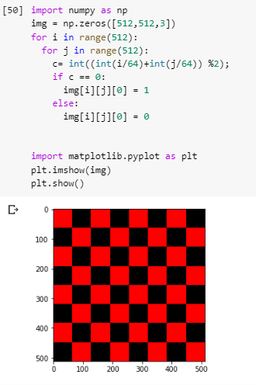
Digital Images

Slide 4
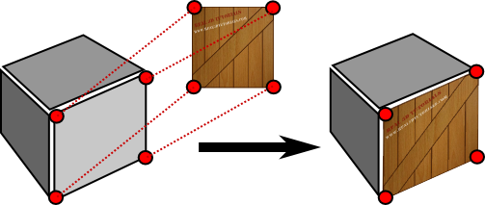
What is Texture Mapping
A graphic design process in which a two-dimensional (2-D) surface, called a texture map, is "wrapped around" a three-dimensional (3-D)object.
3-D object acquires a surface texture similar to that of the 2-D surface.
Texture mapping is the electronic equivalent of applying wallpaper, paint, or veneer to a real object.

Slide 5
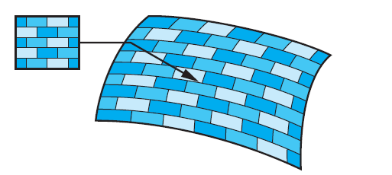
Texture Mapping
Texture mapping uses an image (or texture) to influence the color of a fragment. Textures can be specified using a fixed pattern, such as the regular patterns often used to fill polygons; by a procedural texture-generation method; or through a digitized image.

Slide 6
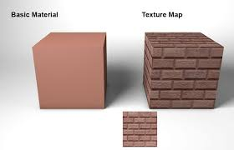
Why Texture Mapping
Adds realism to the scene
Draw a large brick wall without texturing, each brick must be drawn as a separate polygon
But With texturing a large flat wall is just a single polygon

Slide 7
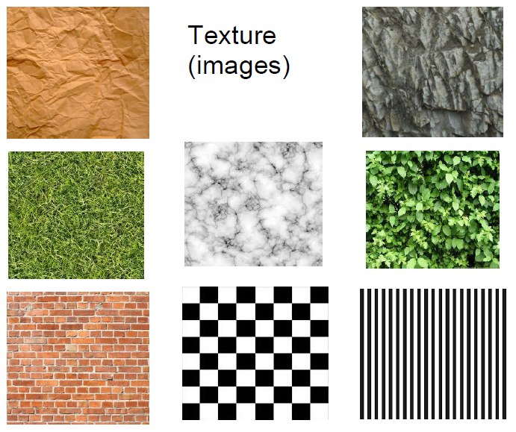
Example of Texture

Slide 8
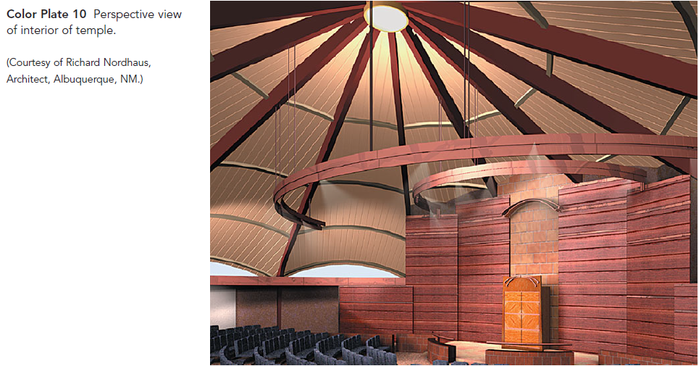
Example of Texture Mapping

Slide 9
Two Dimensional Texture Mapping
Although there are multiple approaches to texture mapping, all require a sequence of steps that involve mappings among three or four different coordinate systems. At various stages in the process, we shall be working with:
screen coordinates, where the final image is produced;
object coordinates, where we describe the objects upon which the textures will be mapped;
texture coordinates, which we use to locate positions in the texture;
and parametric coordinates, which we use to help us define curved surfaces.

Slide 10
Two Dimensional Texture Mapping
A texture map associates a texel with each point on a geometric object that is itself mapped to screen coordinates for display. If the object is represented in homogeneous or (x, y, z, w) coordinates, then there are functions such that
x = x(s, t),
y = y(s, t),
z = z(s, t),
w = w(s, t).

Slide 11
Two Dimensional Texture Mapping
One of the difficulties we must confront is that although these functions exist conceptually, finding them may not be possible in practice. In addition, we are worried about the inverse problem: Having been given a point (x, y, z) or (x, y, z , w) on an object, how do we find the corresponding texture coordinates, or equivalently, how do we find the “inverse” functions
s = s(x, y, z , w),
t = t(x, y, z , w)
to use to find the texel T(s, t)?

Slide 12
Two Dimensional Texture Mapping
If we define the geometric object using parametric (u, v) surfaces, there is an additional mapping function that gives object coordinate values, (x, y, z) or (x, y, z , w) in terms of u and v.
we also need the mapping from parametric coordinates (u, v) to texture coordinates and sometimes the inverse mapping from texture coordinates to parametric coordinates.

Slide 13
Two Dimensional Texture Mapping
One way to think about texture mapping is in terms of two concurrent mappings: the first from texture coordinates to parametric coordinates, and the second from parametric coordinates to object coordinates, as shown in Figure 7.9. A third mapping takes us from object coordinates to screen coordinates.

Slide 14
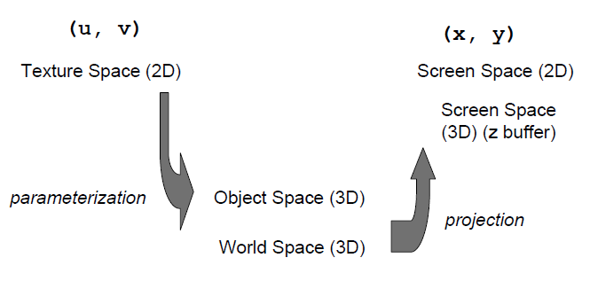
Two Dimensional Texture Mapping

Slide 15
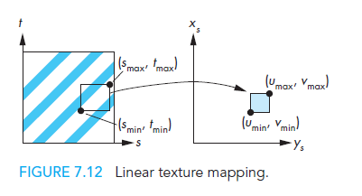
Linear Texture Mapping
Do a direct mapping of a block of texture to a surface patch:

Slide 16
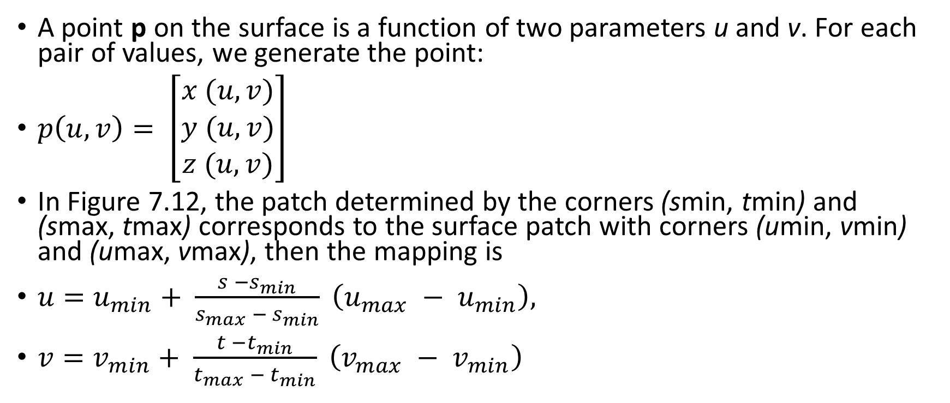
Linear Texture Mapping
A point p on the surface is a function of two parameters u and v. For each pair of values, we generate the point:
$p\left(u,v\right)= \left[\begin{matrix}x (u,v) \\ y (u,v) \\ z (u,v)\end{matrix}\right]$
In Figure 7.12, the patch determined by the corners (smin, tmin) and (smax, tmax) corresponds to the surface patch with corners (umin, vmin) and (umax, vmax), then the mapping is
${u=u}_{min}+ \frac{s −s_{min}}{s_{max} − s_{min}} \left(u_{max} − u_{min}\right),$
${v=v}_{min}+ \frac{t −t_{min}}{t_{max} − t_{min}} \left(v_{max} − v_{min}\right)$

Slide 17
Difficulties in Texture Mapping
First, we must determine the map from texture coordinates to object coordinates. A two-dimensional texture usually is defined over a rectangular region in texture space. The mapping from this rectangle to an arbitrary region in three-dimensional space may be a complex function or may have undesirable properties. For example, if we wish to map a rectangle to a sphere, we cannot do so without distortion of shapes and distances.
Second, owing to the nature of the rendering process, which works on a pixel-by-pixel basis, we are more interested in the inverse map from screen coordinates to texture coordinates.

Slide 18
Difficulties in Texture Mapping
Third, because each pixel corresponds to a small rectangle on the display, we are interested in mapping not points to points, but rather areas to areas. Here again is a potential aliasing problem that we must treat carefully if we are to avoid artifacts, such as wavy sinusoidal or moire’ patterns.

Slide 19
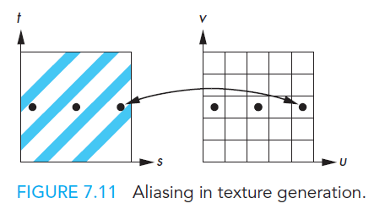
What is aliasing?
An on-screen pixel does not always map neatly to a texel. Particularly severe problems in regular textures.

Slide 20
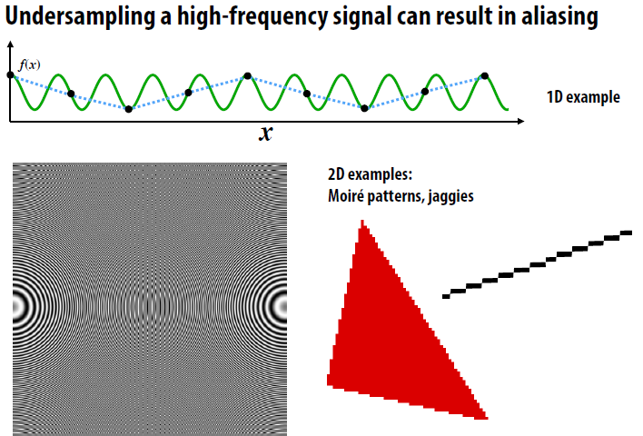
Aliasing

Slide 21
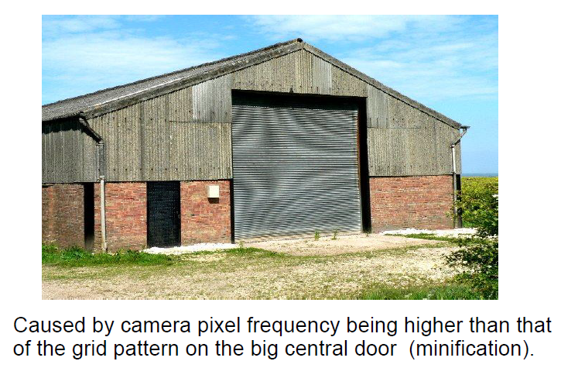
Moire Pattern

Slide 22
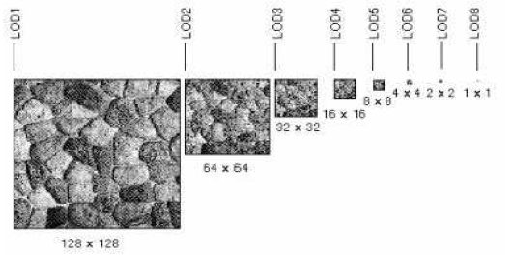
Anti-Aliasing
Pre-calculate how the texture should look at various distances, then use the appropriate texture at each distance. This is called mipmapping.

Slide 23
Specify the Texture
The texture is a single image
Thought of as being two-dimensional but it can be one-dimensional
Four elements per texels (R, G, B, A)
Specify a single texture at many different resolution called mipmapping

Slide 24
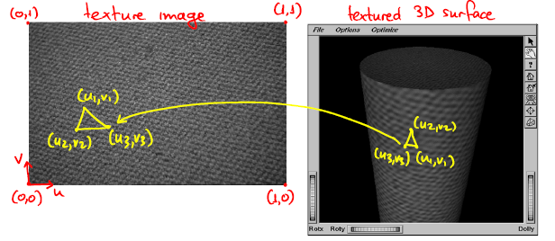
Two Dimensional Texture Mapping

Slide 25
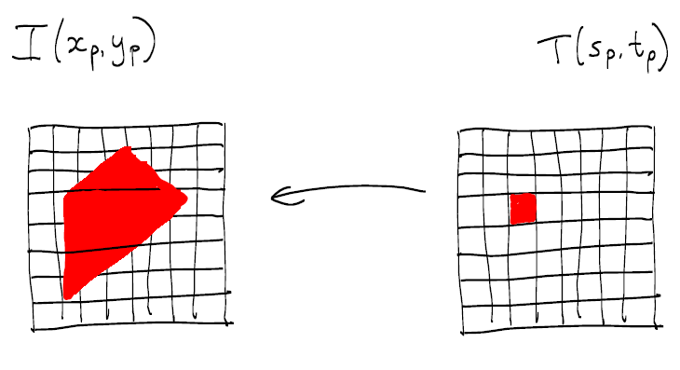
Texture magnification
a pixel in texture image ('texel') maps to an area larger than one pixel in image

Slide 26
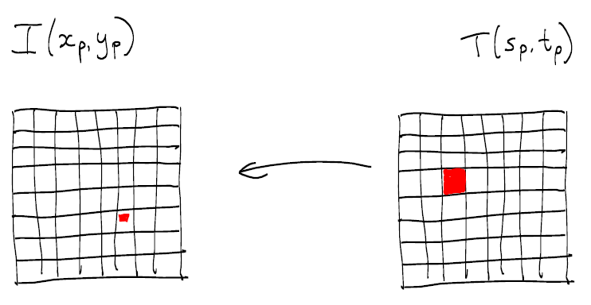
Texture minification
a pixel in texture image('texel') maps to an area smaller than a pixel in image:

Slide 27
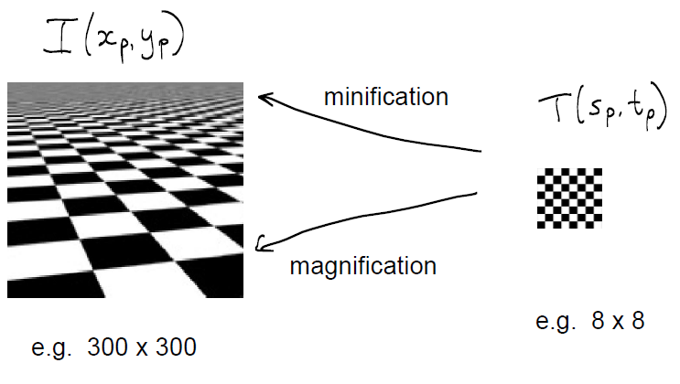
Mipmapping

Slide 28
OpenGL Texture Mapping
OpenGL’s texture maps rely on its pipeline architecture. We have seen that there are actually two parallel pipelines: the geometric pipeline and the pixel pipeline. For texture mapping, the pixel pipeline merges with fragment processing after rasterization, as shown in Figure 7.16. This architecture determines the type of texture mapping that is supported. In particular, texture mapping is done as part of fragment processing. Each fragment that is generated is then tested for visibility with the z-buffer. We can think of texture mapping as a part of the shading process, but a part that is done on a fragment-by-fragment basis.

Slide 29
OpenGL Texture Mapping
Texture mapping requires interaction among the application program, the vertex shader, and the fragment shader. There are three basic steps. First, we must form a texture image and place it in texture memory on the GPU. Second, we must assign texture coordinates to each fragment. Finally, we must apply the texture to each fragment.

Slide 30
glBindTexture
glBindTexture(GL_TEXTURE_2D,textureName);
GL_TEXTURE_2D: Specify that it is a 2D texture
textureName: Name of the texture

Slide 31
glTexImage2D
glTexImage2D(GL_TEXTURE_2D, level, components, width, height, border, format, type, tarray)
GL_TEXTURE_2D: Specify that it is a 2D texture
Level: Used for specifying levels of detail for mipmapping
Components: Generally is 0 which means GL_RGB, Represents components and resolution of components
Width, Height: The size of the texture must be powers of 2
Border Format: Specify what the data is (GL_RGB, GL_RGBA, …)
Type: Specify data type (GL_UNSIGNED_BYTE, GL_BYTE, …)

Slide 32
glTexParameteri
glTexParameteri(GL_TEXTURE_2D, GL_TEXTURE_MAG_FILTER, GL_LINEAR);
This function sets several texture mapping parameters. These parameters are bound to the current texture state that can be made current with glBindTexture.
parameters:
P1: GLenum: The texture target for which this parameter applies. Must be one of GL_TEXTURE_1D, GL_TEXTURE_2D, GL_TEXTURE_3D, or GL_TEXTURE_CUBE_MAP.
P2: GLenum: The texturing parameter to set. GL_TEXTURE_MAG_FILTER Returns the texture magnification filter value
P3: GLfloat or GLfloat* or GLint or GLint*: Value of the parameter specified by pname.

Slide 33
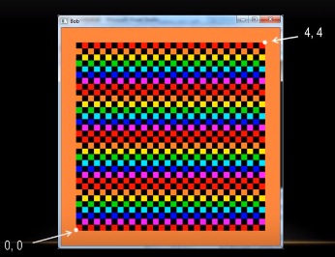
GL_REPEAT Instead of GL_LINEAR

Slide 34
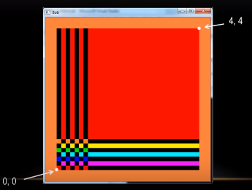
GL_CLAMP

Slide 35
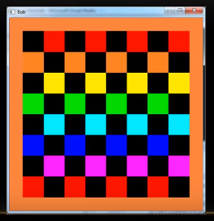
GL_NEAREST

Slide 36
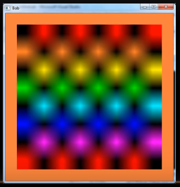
GL_LINEAR

Slide 37
glTexGen
void glTexGeni( GLenum coord, GLenum pname, GLint param);
glTexGen selects a texture-coordinate generation function or supplies coefficients for one of the functions. coord names one of the (s, t, r, q) texture coordinates; it must be one of the symbols GL_S, GL_T, GL_R, or GL_Q.
Coord: Specifies a texture coordinate. Must be one of GL_S, GL_T, GL_R, or GL_Q.
Pname: Specifies the symbolic name of the texture-coordinate generation function or function parameters. Must be GL_TEXTURE_GEN_MODE, GL_OBJECT_PLANE, or GL_EYE_PLANE.

Slide 38
glTexGen
Params: Specifies a pointer to an array of texture generation parameters. If pname is GL_TEXTURE_GEN_MODE, then the array must contain a single symbolic constant, one of GL_OBJECT_LINEAR, GL_EYE_LINEAR, GL_SPHERE_MAP, GL_NORMAL_MAP, or GL_REFLECTION_MAP. Otherwise, params holds the coefficients for the texture-coordinate generation function specified by pname.

